Slide 1

Sales Data Analysis (MeriSKILL INTERNSHIP Project 1)
Joy chinenye Akouwa

Slide 2
PROJECT PLAN
Conclusion
Recommendation
Insights
Dashboard
Project Description

Slide 3
Project Description
In this project, we dived into a large sales dataset to extract valuable insights. With the aim to analyze the sales data to identify trends, top-selling products, and revenue metrics for business decision-making.
Exploring sales trends over time, identifying the best-selling products, calculating revenue metrics such as total sales and profit margins, and created visualization to present findings effectively. This project showcased the ability to manipulate and derive insights from large dataset, to make data-driven recommendation for optimizing sales strategies.

Slide 4
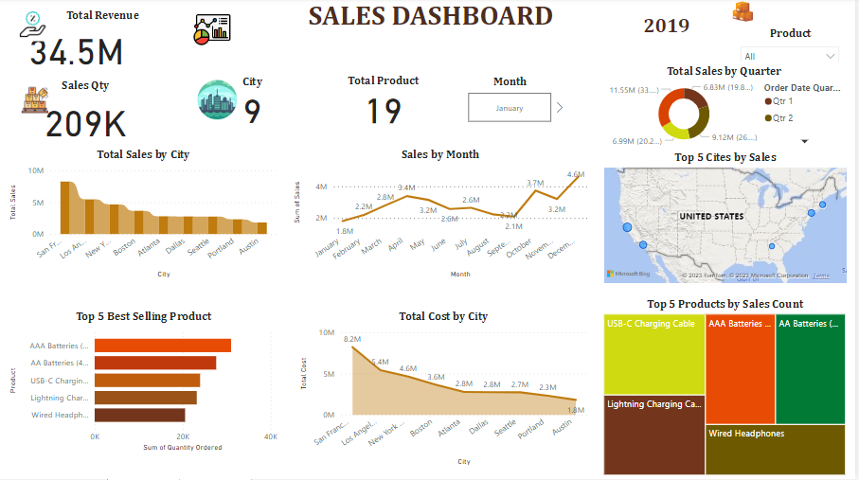
DASHBOARD

Slide 5
KEY INSIGHTS
The Total Revenue is $34.5M which represents the collective earnings of the sales of various products during given time period.
Total Quantity sold is 209K
Number of products sold is 19
Cities where orders were placed is 9
December emerged as the month with the highest sales, contributing significantly to the total revenue with a remarkable $4.6M in sales.
The 4th Quarter stood out as the highest revenue generating period accounting for a substantial $11.55M in total sales. This emphasizes the importance of end-of-year sales.

Slide 6
KEY INSIGHTS
The city of San Francisco emerged as the top contributor to revenue, generating over $8M in sales.
The MacBook Pro laptop was the highest revenue-generating product, contributing $7.87M to the overall sales figure.
AAA Batteries led in terms of quantity with over 300,000 units sold. This highlights the significance of a high-demand, lower-cost item in driving sales volume.
San Francisco, Los Angeles, New York, Boston and Atlanta emerged as leading cities in terms of sales for the company’s product.
AAA Batteries, USB-C Charging Cable, Lightning Charging Cable, AA Batteries 4 pack and Wired Headphones are the top 5 best-selling products.

Slide 7
RECOMMENDATION
Utilize the fact that December is the month with biggest sales to execute focused seasonal promotions.
Considering that the 4th quarter is the highest revenue period, consider stepping up marketing initiatives and product launches during that time.
Considering that San Francisco is the city that generated the most money, concentrate marketing efforts and campaigns on the tastes and demographics of this area.
Examine options to improve the product mix while acknowledging the MacBook Pro’s major contribution to the overall income. This could entail adding varieties, bundles, or complementing accessories to increase overall sales to this top-performing product.

Slide 8
RECOMMENDATION
Considering that approximately 300,000 units of AAA Batteries have been ordered, it is important to have a string supply chain. This entails keeping appropriate stock levels, refining pricing tactics, and looking at ways to buy in bulk in order to take advantage of the strong demand.

Slide 9
CONCLUSION
In conclusion, this sales analysis, offers a path for making strategic decisions that will improve overall sales performance. The identification of trends patterns, like impact of particular quarter, cities, months, and products, enables the organization to customize its strategy for optimal effect.
By putting the suggested strategies into practice, the company may make use of its current advantages and proactively address possible areas for expansion.

Slide 10
THANK YOU

